Slide 1
EEE 109 Electrical Circuits
Dr. Md. Forkan Uddin
Associate Professor
Department of Electrical and Electronic Engineering (EEE)
Bangladesh University of Engineering and Technology (BUET)

Slide 2
Methods of Analysis
Boylestad – Chapter 8

Slide 3
Topics to be Covered
Mesh (loop) analysis
Nodal analysis

Slide 4
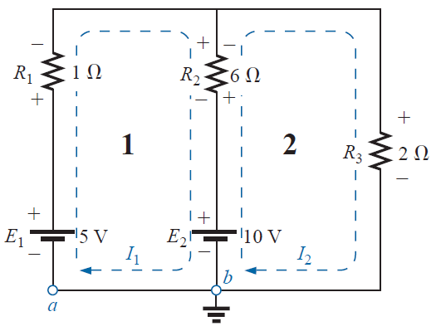

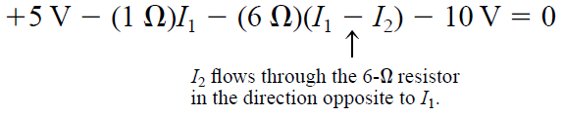

Mesh (Loop) Analysis
Mesh (loop) Analysis
Procedure (General Approach)
1. Assign a loop current to each independent, closed loop in a CW direction
2. Indicate the polarities within each loop for each resistor as determined by the assumed direction of loop current for that loop
3. Apply KVL around each closed, independent loop of the network
4. Solve the resulting simultaneous equations for the desired loop currents
+
V₃
-
I₁ = 1 A, I₂ = 2 A, V₃ = 6 V

Slide 5
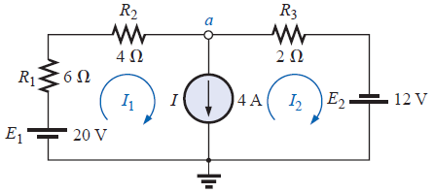
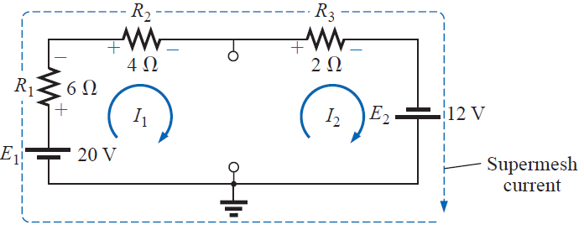

Mesh (Loop) Analysis
Supermesh Currents
Procedure (General Approach)
1. Assign a loop current to each independent, closed loop in a CW direction
2. Indicate the polarities within each loop for each resistor as determined by the assumed direction of loop current for that loop
3. Remove all the current sources by open circuit
4. Apply KVL around the remaining loops of the network
5. Relate the mesh currents to the independent current sources
6. Solve the resulting equations for the desired loop currents
Supermesh
Meshcurrents
I₁ = 3.33 A, I₂ = - 0.67 A

Slide 6
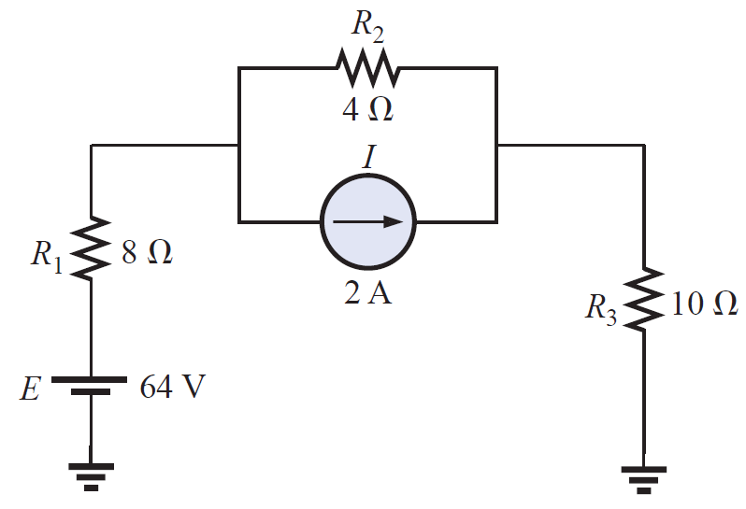
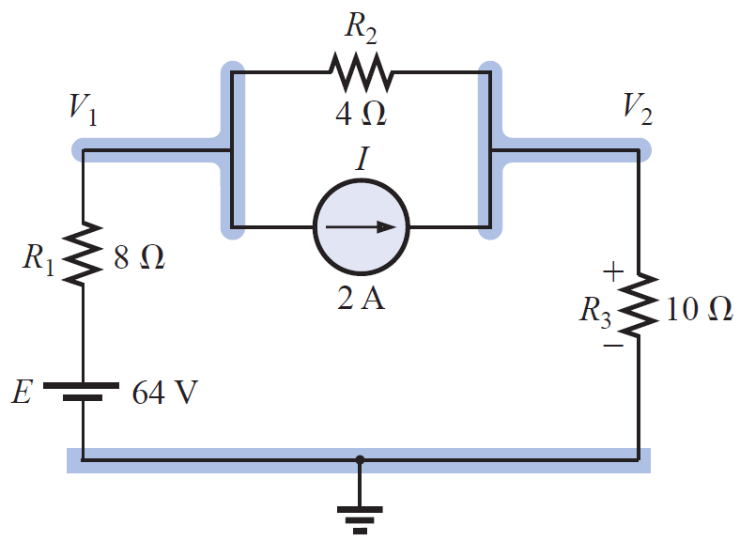

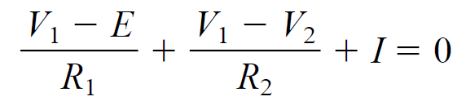

Nodal Analysis
Procedure (General Approach)
1. Determine the number of nodes within the network
2. Pick a reference node, and label each remaining node with a subscripted value of voltage: V₁, V₂ and so on
3. Apply KCL at each node except the reference
4. Solve the resulting equations for the nodal voltages
+
V_{x}
-
P₃
Node 1
V_{x} = V₁ – E = - 26.182 V
P₃ = (V₂)²/R₃ = 107.10 W
Node 2

Slide 7
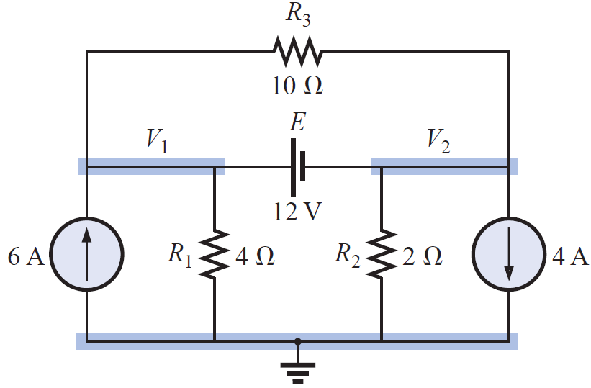
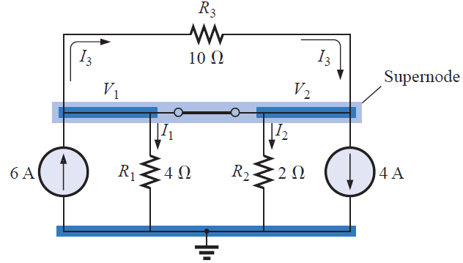
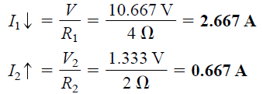
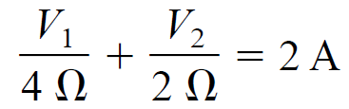



Nodal Analysis
Supernode
Procedure (General Approach)
1. Determine the number of nodes within the network
2. Pick a reference node, and label each remaining node with a subscripted value of voltage: V₁, V₂ and so on
3. Remove all the voltage sources by short circuits and form the supernodes
4. Apply KCL at each node except the reference
5. Relate the node voltages with the voltage sources
6. Solve the resulting equations for the nodal voltages
V₁ = 10.667 V, V₂ = -1.333 V
Super node
Node Voltages

